Slide 1
Capstone Project
Bike Sharing Demand Prediction
SUBMITTED BY
SAMPANNA MISHRA

Slide 2
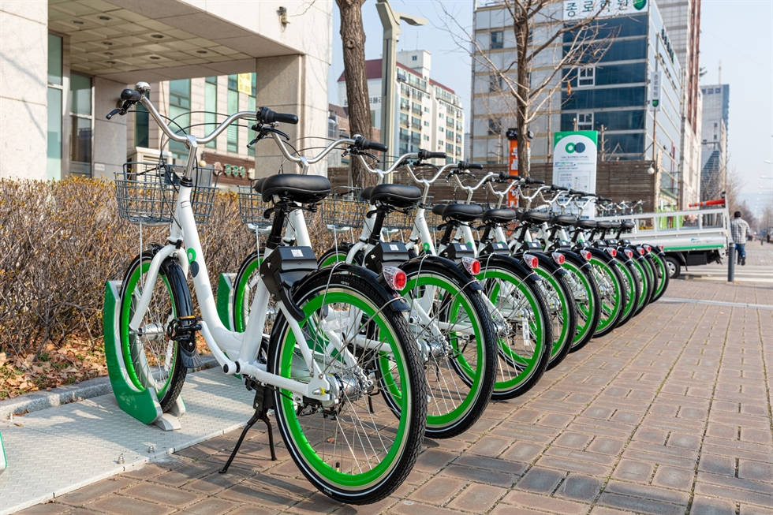
CONTENTS
BUSINESS UNDERSTANDING
DATA SUMMARY
DATA PREPROCESSING
EXPLORATORY DATA ANALYSIS
IMPLEMENTING ML ALGORITHMS
CHALLENGES
CONCLUSION

Slide 3
BUSINESS UNDERSTANDING
Hyper urbanization, coupled with decentralization, has caused a host of transportation problems: gridlock, increasing travel demand,tailpipe emissions, and decreasing accessibility.Hyper-motorization and expanding urban form have contributed to problems of congestion and degrading levels of transit. While in recent years, dozens of cities have implemented bike share systems in efforts to mitigate some of these problems.
Bike sharing systems are a means of renting bicycles where the process of obtaining membership, rental, and bike return is automated throughout a city. Using these systems, people are able rent a bike from a one location and return it to a different place if they need. With an accurate demand prediction model, shared bikes, though with a limited amount, can be effectively utilized whenever and wherever there are travel demands.
The aim of the project is the prediction of bike count required at each hour for the stable supply of rental bikes.

Slide 4
DATA SUMMARY
TARGET VARIABLE
Rented Bike Count
NUMERICAL TYPE
Temperature
Humidity
Wind speed
Visibility
Dew point temperature
Solar Radiation
Rainfall
Snowfall
DATA TYPES
CATEGORICAL TYPE
Seasons
Holiday
Functioning Day
DATETIME TYPE
Date

Slide 5
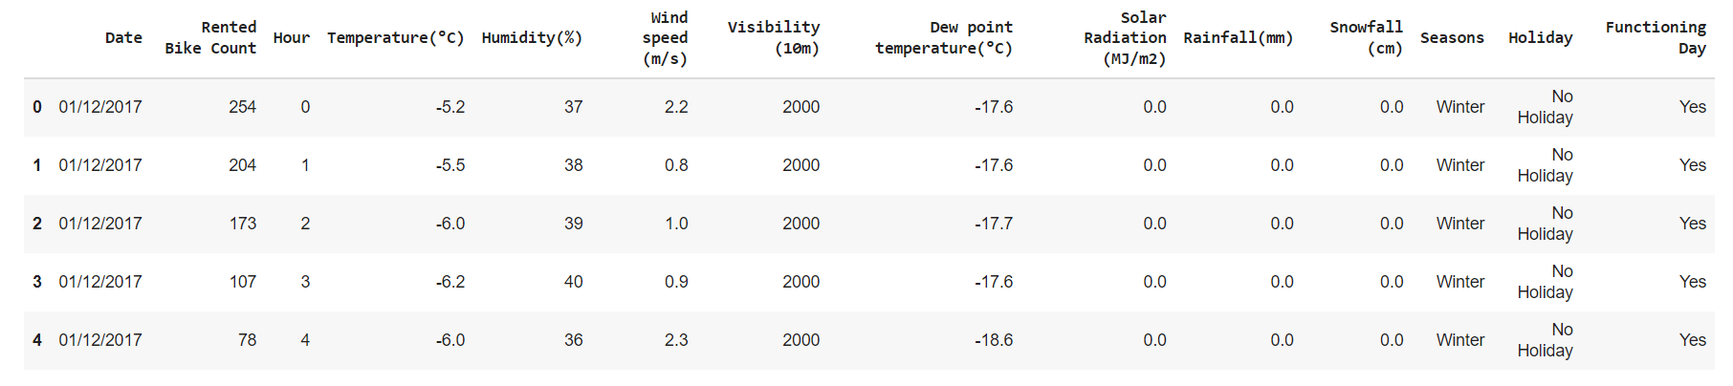
DATA SUMMARY
The dataset contains 8760 rows and 14 columns.
Initially the data types of Date column is given as object and Hour column as integer.However,for convenience in further analysis it has been converted to datatime format and categorical type respectively.

Slide 6
DATA SUMMARY
FList of features given in the dataset are as follows:
Date - days from 01/12/2017 to 30/11/2018, formatting in DD/MM/YYYY, type : str, we need to convert into datetime format.
Rented Bike count - Count of bikes rented at each hour
Hour - The hour of the day, starting from 0-23 it's in a digital time format, type : int, we need to convert it into category data type.
Temperature-Temperature in Celsius, type : Float
Humidity - Humidity in the air in %, type : int
Wind Speed - Speed of the wind in m/s, type : Float

Slide 7
DATA SUMMARY
Visibility - Visibility in m, type : int
Dew point temperature - Temperature at the beginning of the day, type : Float
Solar radiation - Sun contribution (MJ/m2), type : Float
Rainfall - Amount of raining in mm, type : Float
Snowfall - Amount of snowing in cm, type: Float
Seasons - Season of the year, type : str, there are only 4 seasons in data(Winter, Spring, Summer, Autumn)
Holiday -If the day is holiday period or not, type: str
Functional Day - NoFunc(Non Functional Hours), Fun(Functional hours)

Slide 8
DATA PREPROCESSING
There is no missing values present in the dataset.
There is no duplicate values present in the dataset.
The Date column has been divided into hour , months and days to perform detailed analysis.
Further changing the hours, months ,days from integer type to categorical data types.
Out of seven days a week segregating Sunday and Saturday as one category and rest five days into another.
Apply one hot encoding on columns like Holiday , Functioning Day.
Perform label encoding on column Season.
The Rented Bike Count has been considered as the dependent / target variable. Rest of the columns are independent variables.

Slide 9
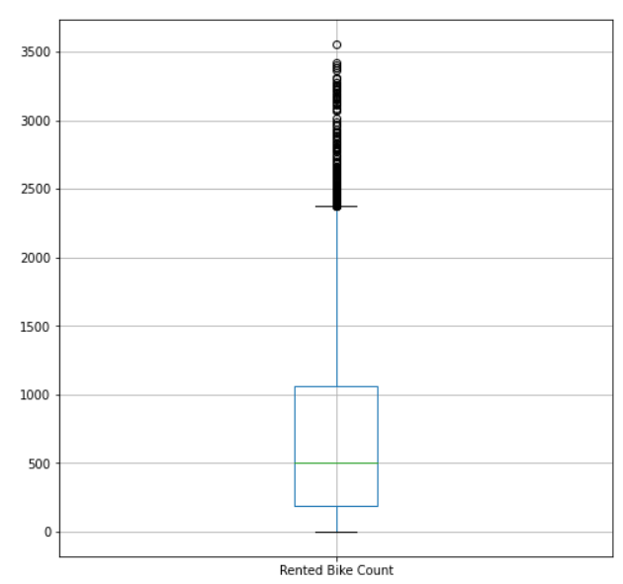
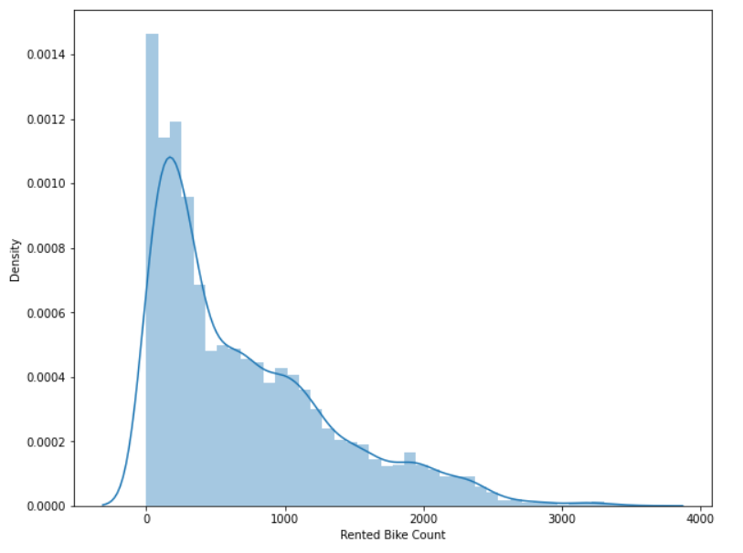
DATA PREPROCESSING
The above plots display that rented bike counts column has outliers in it. Also the data shows positive skewness.It advisable to get rid of outliers before proceeding with further analysis.

Slide 10
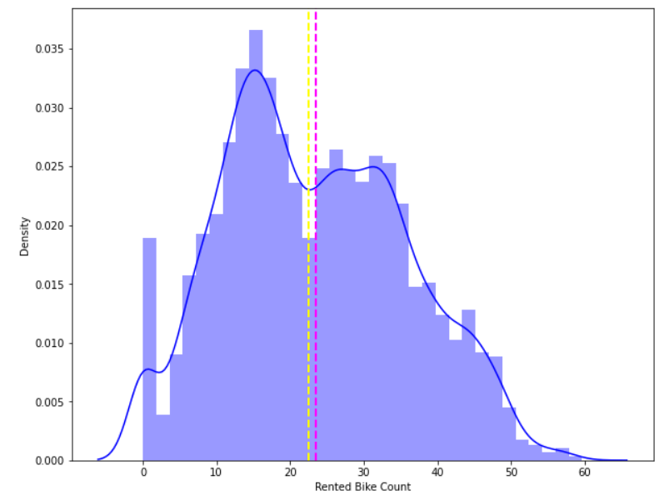
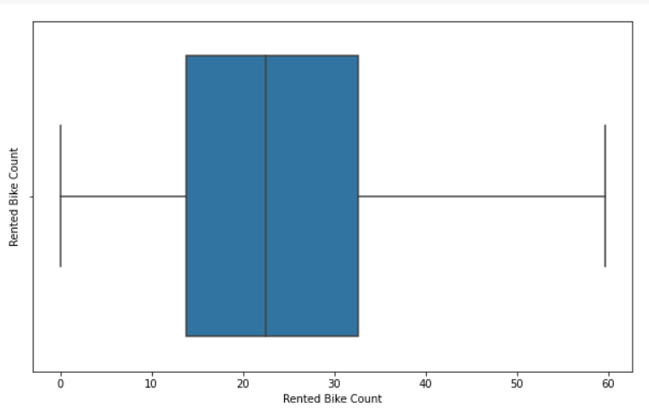
DATA PREPROCESSING
Outlier has been removed using square root treatment. After which the data in the density plot takes roughly a shape of normal distribution.

Slide 11
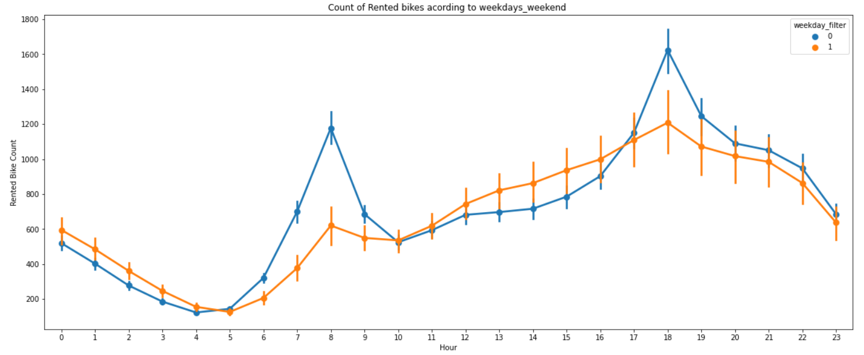
EXPLORATORY DATA ANALYSIS
The blue lines denotes the week days rented bikes count. Orange line denotes the weekends.
On weekdays demand for bikes increases around 7a.m to 9a.m.In the evening the demand again reaches its peak around 5p.m to 7p.m.
show that the demand of rented bikes are quite less specially in the morning hour but when the evening start from 4 pm to 8 pm the demand slightly increases.

Slide 12
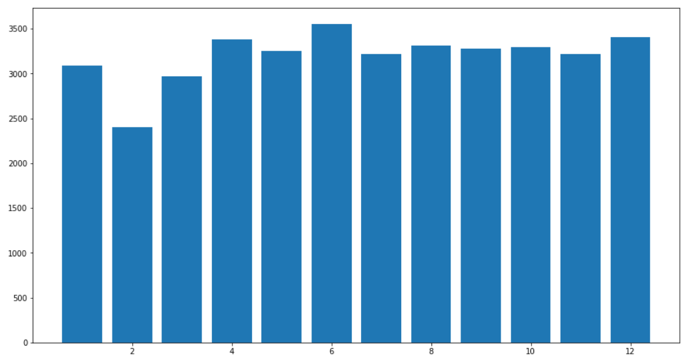
EXPLORATORY DATA ANALYSIS
The figure shows the months denoted as numbers in x-axis and Count of rented bikes in Y axis.
From the plot it is evident that month 6 i.e June has highest bike demand.
While month 2 i.e February has lowest demand.

Slide 13
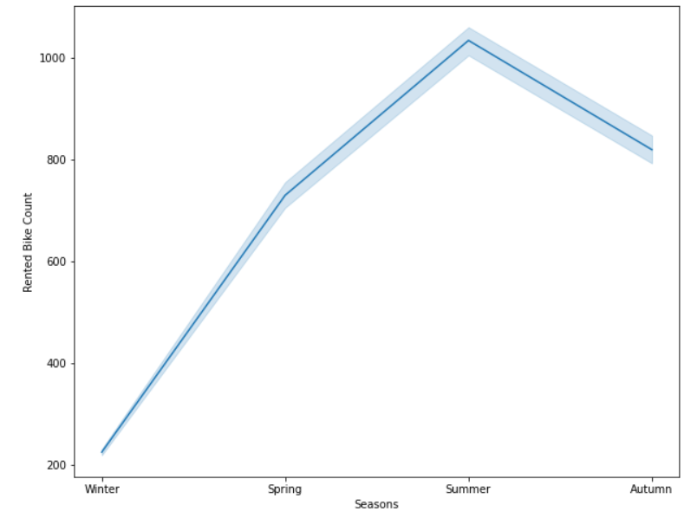
EXPLORATORY DATA ANALYSIS
The season column has four different types of categories namely summer, winter, spring, winter.
Rented Bike Count is highest in month of Summer and lowest in winter season.
This might be because due to harsh weather conditions in winter people don't prefer to travel in bike.

Slide 14
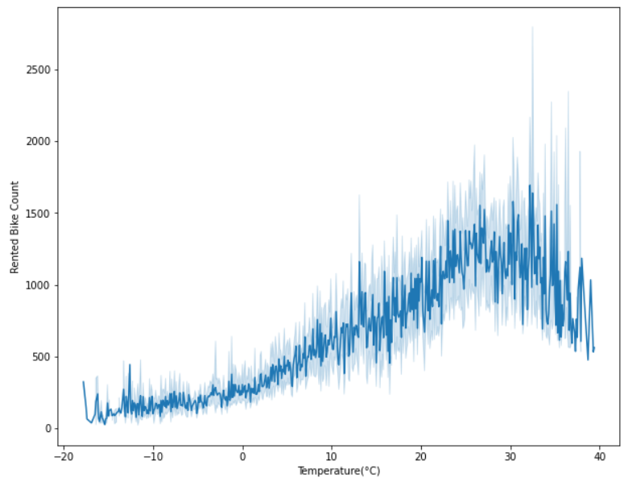
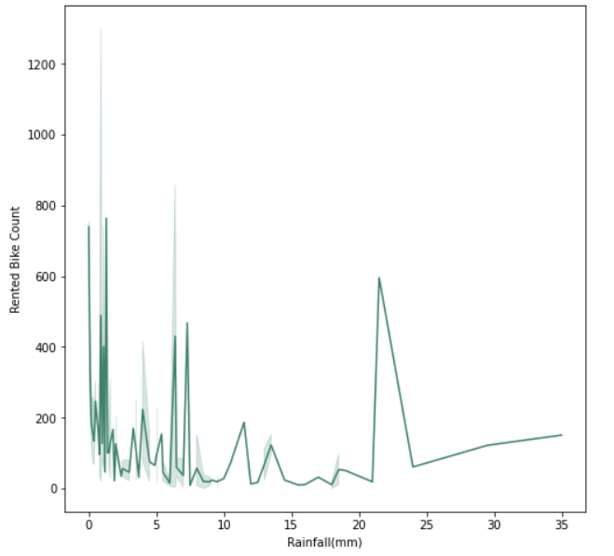
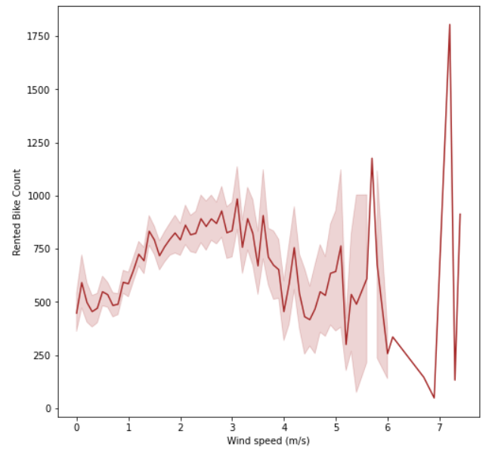
EXPLORATORY DATA ANALYSIS
The trend of the temperature graph shows that there is peak in demand of bikes even if range of temperature increases.
Plot displays that even if it rains a lot the demand of of rent bikes is not decreasing, here for example even if we have 20 mm of rain there is a big peak of rented bikes.

Slide 15
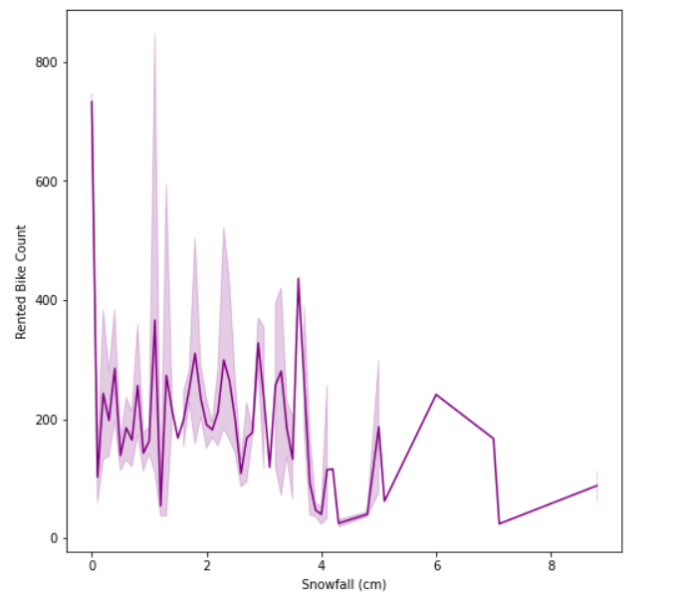
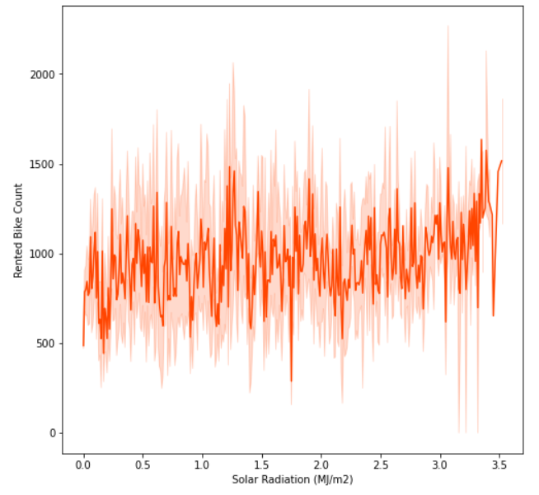
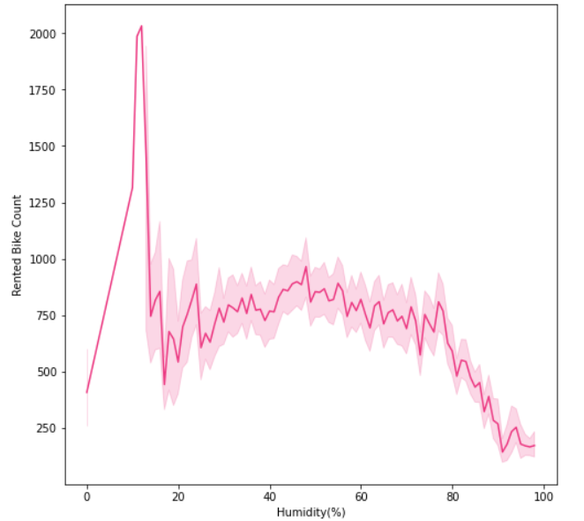
EXPLORATORY DATA ANALYSIS
The plot shows that, on the y-axis, the amount of rented bike is very low. When we have more than 4 cm of snow, the bike rents is much lower.
From the above plot we see that, the amount of rented bikes is huge, when there is solar radiation, the counter of rents is around 1000.
The bike demand increases around humidity 14% to 19%.There is a decreasing trend of bike demand as the humidity increases.

Slide 16
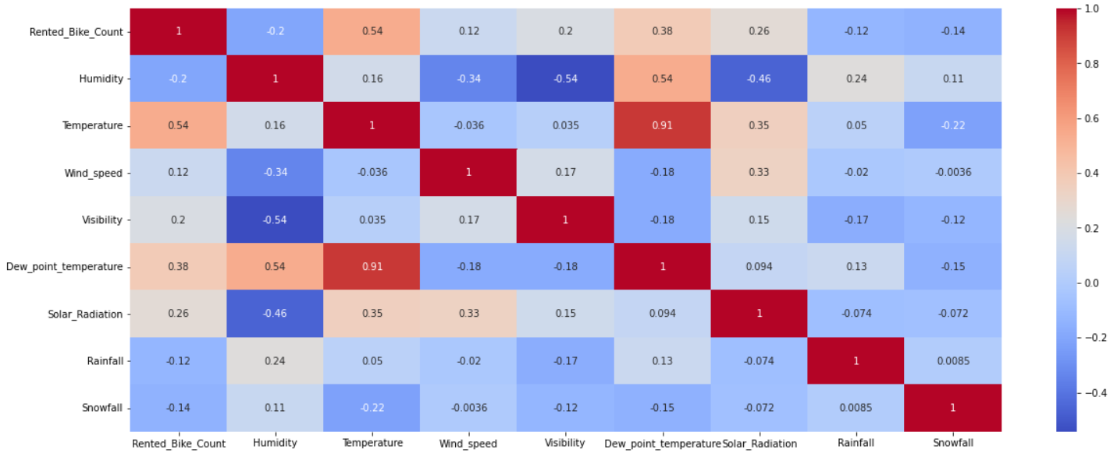
EXPLORATORY DATA ANALYSIS
Features sharing high correlation were dropped from the dataset.E.g Temperature and dew_point_temperature.

Slide 17
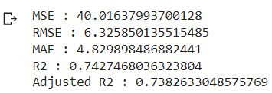
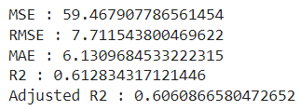
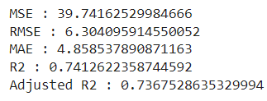
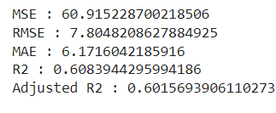
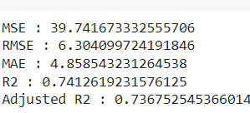
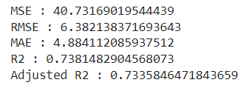
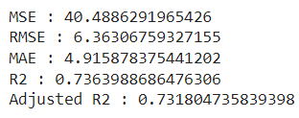
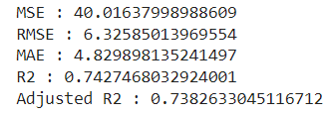
IMPLEMENTING ML ALGORITHM
LINEAR REGRESSION
LASSO REGRESSION
TrainResult
TestResult
TrainResut
TestResult
RIDGE REGRESSION
ELASTIC NET REGRESSION
TrainResult
TestResult
TrainResult
TestResult

Slide 18
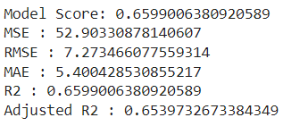
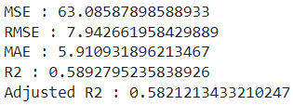
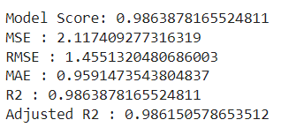
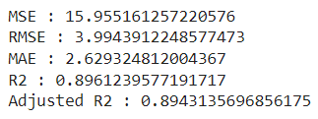
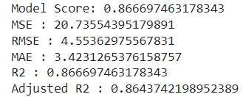
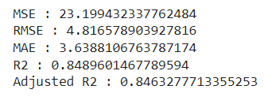
IMPLEMENTING ML ALGORITHMS
DECISION TREE
RANDOM FOREST
TrainResult
TestResult
TrainResult
TestResult
GRADIENT BOOSTING
TrainResult
TestResult

Slide 19
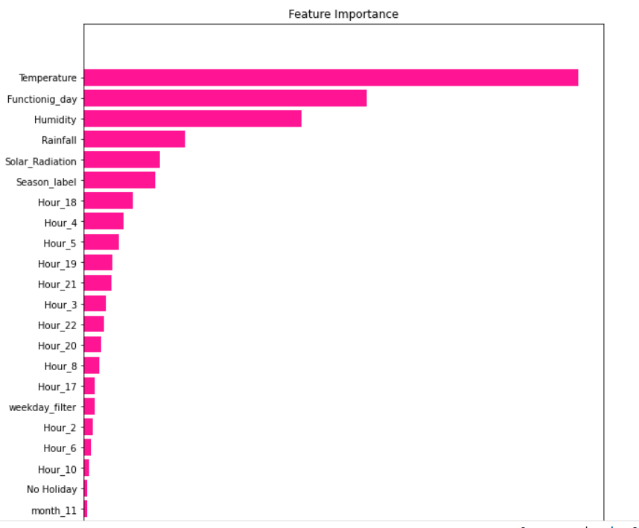
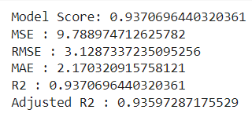
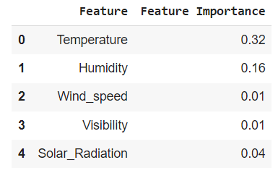
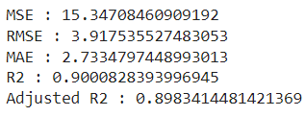
IMPLEMENTING ML ALGORITHM
GRADIENT BOOSTING REGRESSOR WITH HYPERPARAMETER TUNING
TrainResult
TestResult

Slide 20
CHALLENGES
Dealing with huge number of features and plotting that many graphs.
Optimising the ML models.
Finding the best set of parameters to train and test the model.

Slide 21
CONCLUSION
Date column shares important relationship with rented bike count column.From visualization graphs can be concluded that bike demand is greater in weekdays than in weekends.
Rented bike count peak time are 7 am to 9 am in the morning and 5 pm to 7 pm in the evening.Shows that the demand of rented bikes are very low especially in the morning hour.
After analysing the climatic features it can be concluded that generally prefer to rent bike at moderate to high temperatures and when little windy.
Bike rental counts increases in summer season and autumn season.In winter bike demand is low.
With increase in humidity the rental count decreases.In rainy days bike demand does not decrease much. In extreme snowy weather demand declines.
It can be concluded the Gradient Boosting with gridsearchcv is the best fit model as it gave the best R Score i.e 0.90 for the test data.
From feature importance graph it can be concluded that Temperature variable affects the most.

Slide 22
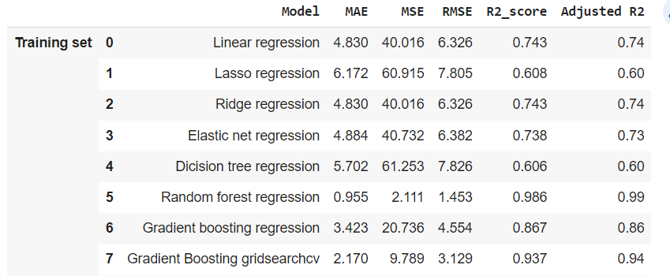
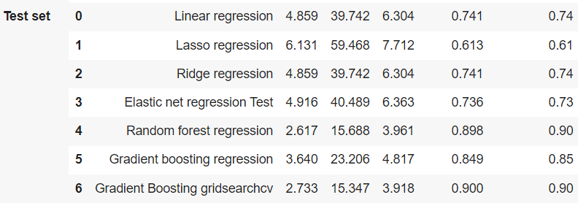
CONCLUSION
Comparing the R2_score of various ML models in Test set ,Gradient Boosting with gridsearch CV is giving the highest R2_score.This can be chosen as the best model to work for prediction purposes for rented bikes.

